Slide 1


PROJECT TYPING SPEED TESTER !
Presented By
SAMYAK SHAMBHARKAR
PRANAY KHARABE
Guided By
Department of Computer Science & Engineering
S. B. JAIN INSTITUTE OF TECHNOLOGY MANAGEMENT AND RESEARCH,NAGPUR
An Autonomous Institute, Affiliated to RTMNU, Nagpur

Slide 2
Contents-
Problem Statement & Objectives
Introduction
System Design
Technology to be Used
Screenshots
Advantages & Applications
References
S. B. Jain Institute of Technology Management and Research
‹#›

Slide 3

Problem Statement & Objectives
Problem Statement :
Nowadays, a good typing is very essential in this digital era if you works with with computer. As the world is adopting digitalization and computerized jobs are increasing, every single working in this field must have a good typing speed. Therefore, we have developed this web app to enhance and test the typing speed of the user.
Objectives :
To improve typing speed of user.
To test the typing speed.
To improve the typing accuracy of user.
‹#›
S. B. Jain Institute of Technology Management and Research

Slide 4
Introduction
In today’s World, typing is a thing on which very less people give attention. But, if you works with computers and earn through that work then it is essential to give attention towards your typing. But, it is not possible that instead of giving attention to your work giving your time to typing. So, what should we do then? So, we made a solution for that which is our Typing Speed Tester project. It helps you master your typing skills in one minute. Just give your one minute everyday and in return it will boost your typing speed as well as the accuracy.
S. B. Jain Institute of Technology Management and Research
‹#›

Slide 5
System Design: Flowchart
start
Initialize the DOM
set all the panels and buttons
Take Input for Execution
Enter Key
Check current
Time
Check Time
Not valid
Increment in Invalid Counter
is time available
Exercise is not completed
if valid char
Increment in Correct Counter
Time available
Get another exercise
Exercise is over
Show Results
Time up
end

Slide 6
Use case Diagram
USER
COMPUTER
TYPING SPEED TEST
(APPLICATION)
USER GIVE TYPING TEST
END
GET RESULT
(WPM,Accuracy, time taken )
S. B. Jain Institute of Technology Management and research
‹#›

Slide 7
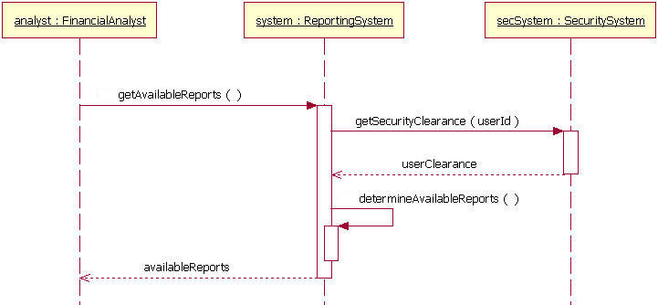
Sequence Diagram
Analyst: Client
getContent()
getAvailableReports
Determine Available Reports

Slide 8
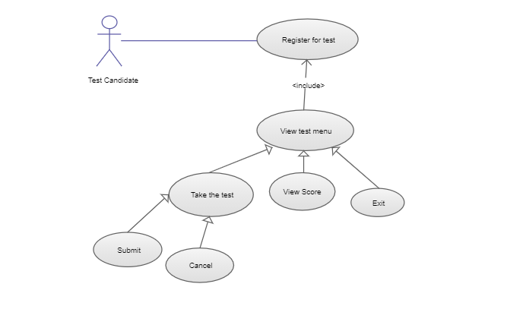
System Architecture
Start the test
Show Results
Restart the test
S. B. Jain Institute of Technology Management and research
‹#›

Slide 9
Technology to be Use
Front End:
Javascript , CSS, HTML
Library/API/Framework: n/a
IDE: VS CODE
Hardware used: n/a
S. B. Jain Institute of Technology Management and research
‹#›

Slide 10
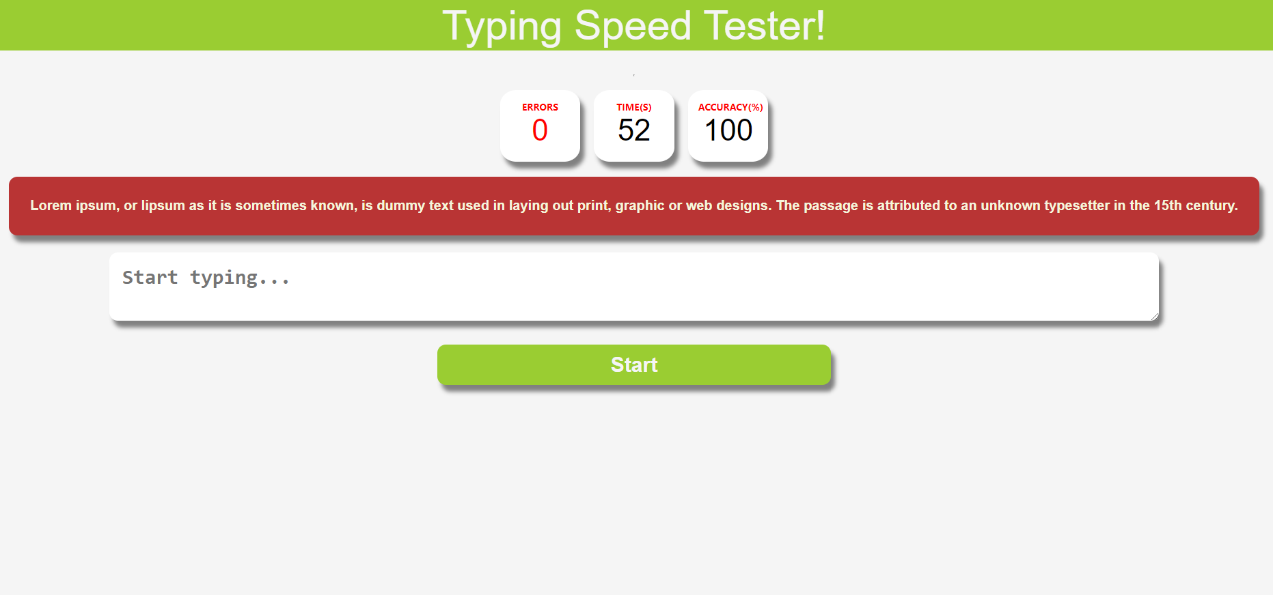
Screen Shots
Here it will display this type of interphase where you will see some content and then start typing. There will be by default 60 sec timer and in the end of this test it will display your result i.e errors, speed, accuracy.
S. B. Jain Institute of Technology Management and Research
‹#›

Slide 11
Advantages & Applications
The interphase of typing speed tester is very simple. For beginners it is the best platform.
This application can improve your typing speed and also accuracy.
In the end of the test, it will display the result on screen in terms of WPM, ACCURACY, TIME TAKEN.
S. B. Jain Institute of Technology Management and Research
‹#›

Slide 12
References
Websites:
www.w3schools.com
www.geeksforgeeks.com
Books: Javascript basics, learning web-design.
S. B. Jain Institute of Technology Management and Research
‹#›

Slide 13
Thank You

